Slide 1
Network Topologies
CSE307
Exp 3

Slide 2
Network Topology
The topology of a network defines how the nodes of a network are connected.
The shape of the cabling layout used to link devices is called the physical topology of the network.

Slide 3
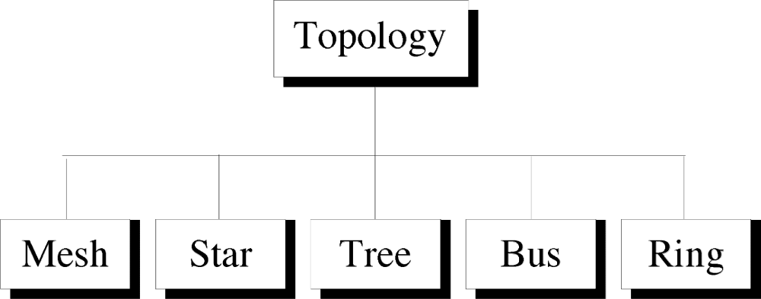
Categories of Physical Topology

Slide 4
POLL 1
Which of the following is a example of the topologies
Car
Bus
Truck
Train

Slide 5
Mesh Topology
Here every device has a point to point link to every other device.
Node 1 node must be connected with n-1 nodes.
A fully connected mesh can have n(n-1)/2 physical channels to link n devices.
It must have n-1 I/O ports.

Slide 6
POLL 2
If there are 15 devices, then how many channels are required in a mesh topology
150
125
200
250

Slide 7

A fully connected mesh topology (five devices)
1.<number>
Notes:
1.#

Slide 8
Advantages of Mesh
They use dedicated links so each link can only carry its own data load. So traffic problem can be avoided.
It is robust. If any one link get damaged it cannot affect others.
It gives privacy and security.(Message travels along a dedicated link)
Fault identification and fault isolation are easy.

Slide 9
Disadvantages of Mesh
The amount of cabling and the number of I/O ports required are very large. Since every device is connected to each devices through dedicated links.
The sheer bulk of wiring is larger then the available space.
Hardware required to connected each device is highly expensive.

Slide 10
Applications of Mesh
Telephone Regional office.
WAN.(Wide Area Network).

Slide 11
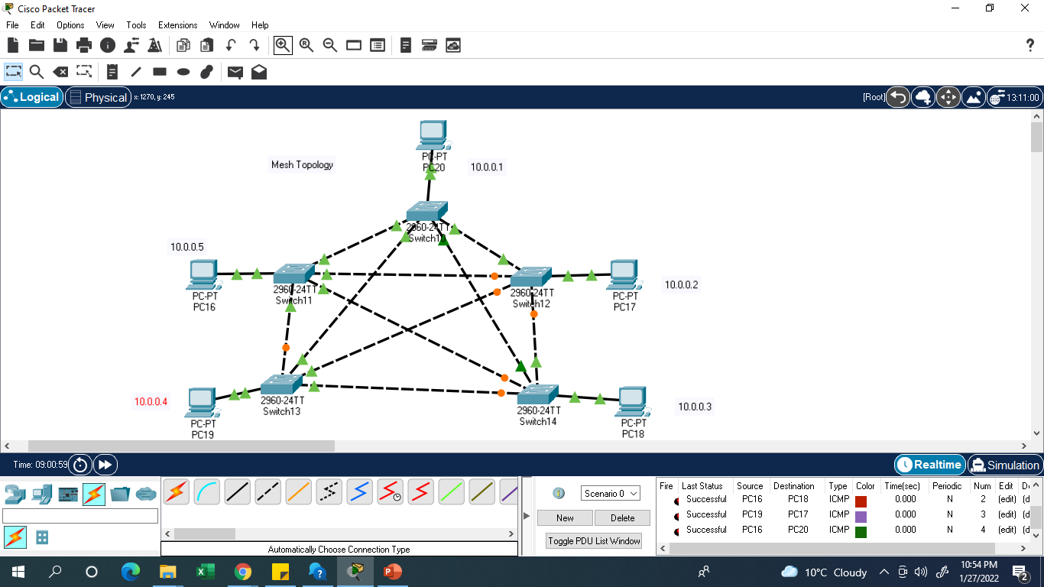


Slide 12
Star Topology
Here each device has a dedicated point-to-point link to the central controller called “Hub”(Act as a Exchange).
There is no direct traffic between devices.
The transmission are occurred only through the central “hub”.
When device 1 wants to send data to device 2; First sends the data to hub. Which then relays the data to the other connected device.

Slide 13

Star Topology

Slide 14
Advantages of Star Topology
Less expensive then mesh since each device is connected only to the hub.
Installation and configuration are easy.
Less cabling is need then mesh.
Robustness.(if one link fails, only that links is affected. All other links remain active)
Easy to fault identification & to remove parts.
No distruptions to the network then connecting(or) removing devices.

Slide 15
Disadvantages of Star Topology
Even it requires less cabling then mesh when compared with other topologies it still large.(Ring or bus).
Dependency(whole n/w dependent on one single point(hub). When it goes down. The whole system is dead.

Slide 16
Applications of Star Topology
Star topology used in Local Area Networks(LANs).
High speed LAN often used STAR.

Slide 17
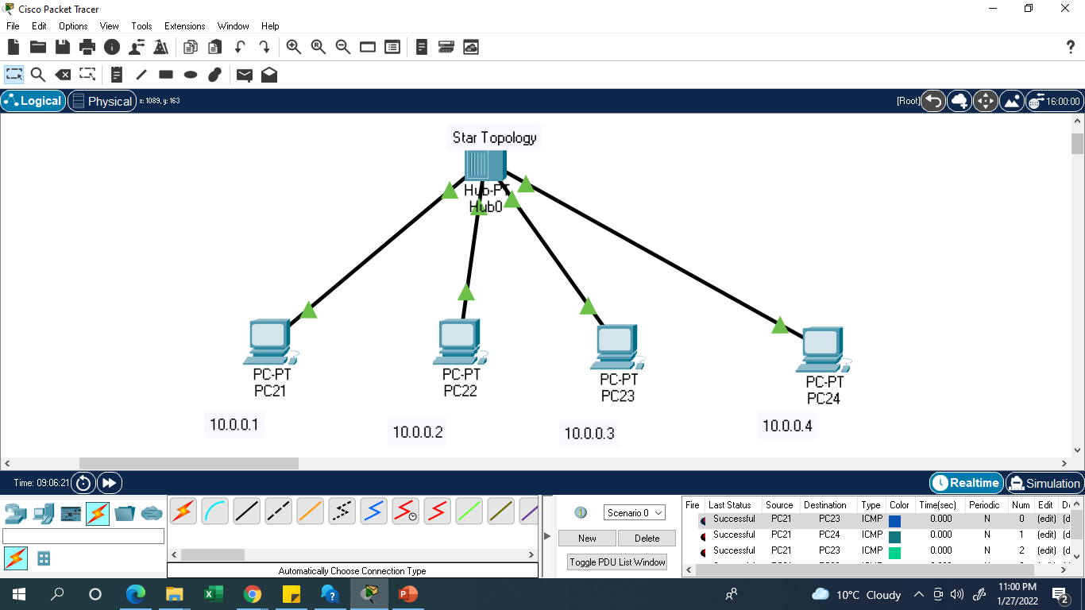

Slide 18
Bus Topology
A bus topology is multipoint.
Here one long cable act as a backbone to link all the devices are connected to the backbone by drop lines and taps.
Drop line- is the connection b/w the devices and the cable.
Tap- is the splitter that cut the main link.
This allows only one device to transmit at a time.

Slide 19

Bus Topology

Slide 20
When a device sends a message, it is broadcast down on the cable in both directions. Terminators at the end of the cable prevent the signal from reflecting back to the sender.
All devices on the cable constantly monitor for messages meant to them. When a device detects a message meant for it, it reads the message from the cable and the other devices will ignore it.
Since all devices are sharing the same cable, some form of control is needed to make sure which device will transmit when, otherwise there will be a collision.

Slide 21
Advantages of Bus Topology
Ease of installation.
Less cabling.
less expensive.

Slide 22
Disadvantages of Bus Topology
Difficult reconfiguration and fault isolation.
Difficult to add new devices.
Signal reflection at top can degradation in quality.
If any fault in backbone can stops all transmission.

Slide 23
Applications of Bus Topology
Most computer motherboard.

Slide 24
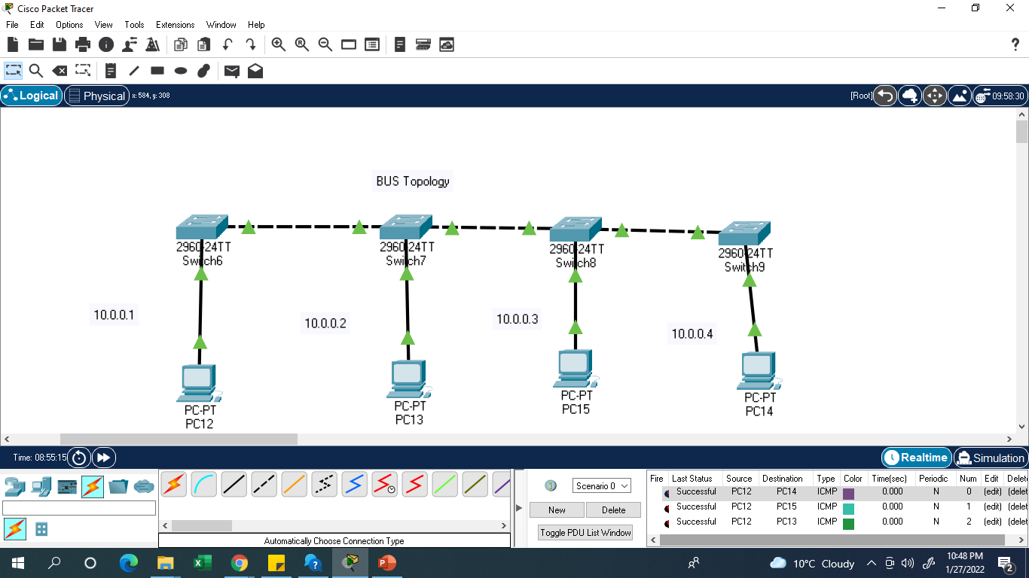

Slide 25
Tree Topology
Alternatively referred to as a star bus topology.
Tree topology is one of the most common network setups that is similar to a bus topology and a star topology.
A tree topology connects multiple star networks to other star networks. Below is a visual example of a simple computer setup on a network using the star topology.

Slide 26
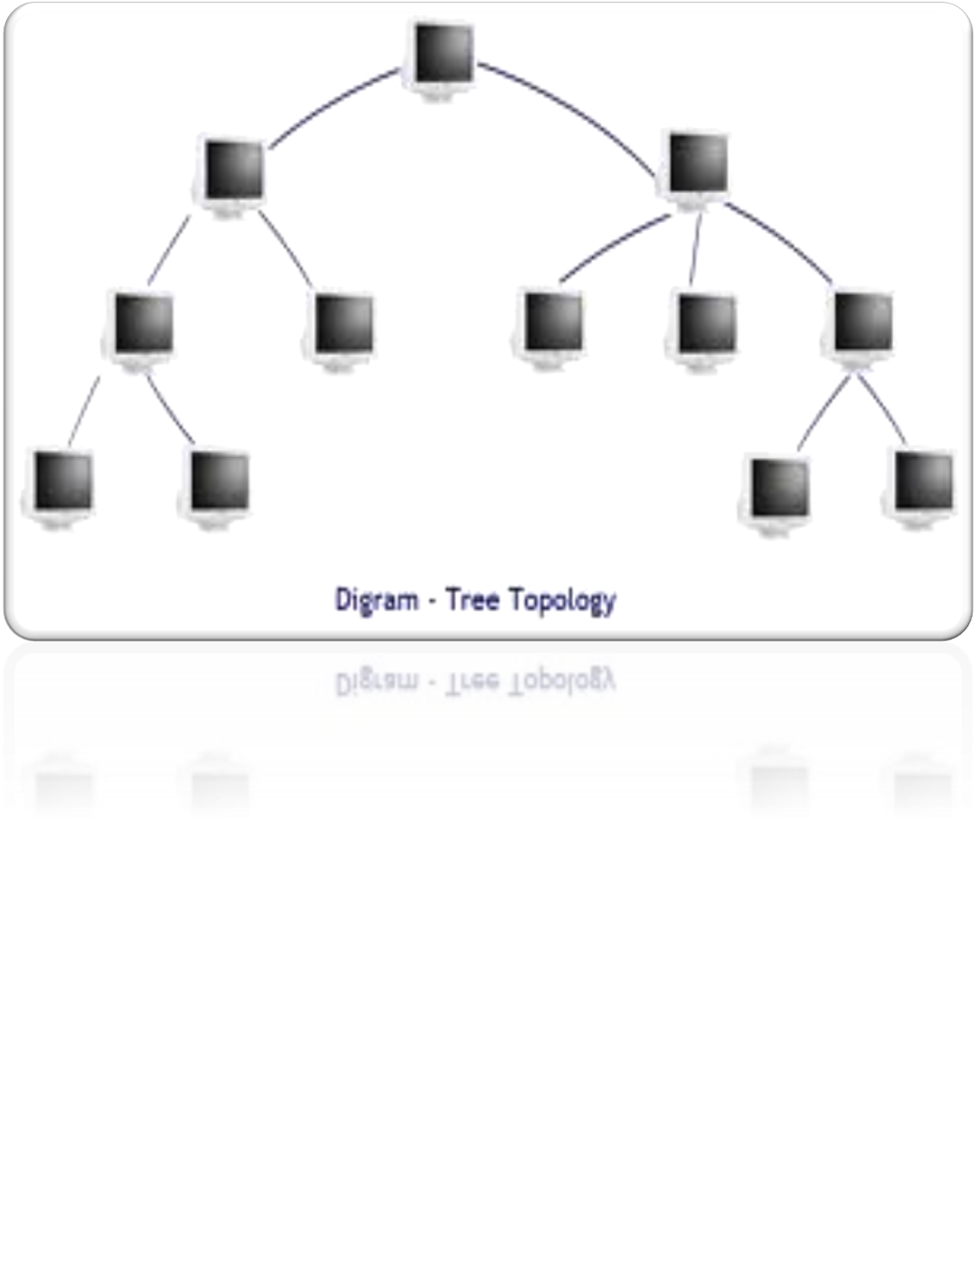

Slide 27
POLL 3
Which of the following topology is the most expensive in terms of installation
Star
Bus
Mesh
Hub

Slide 28
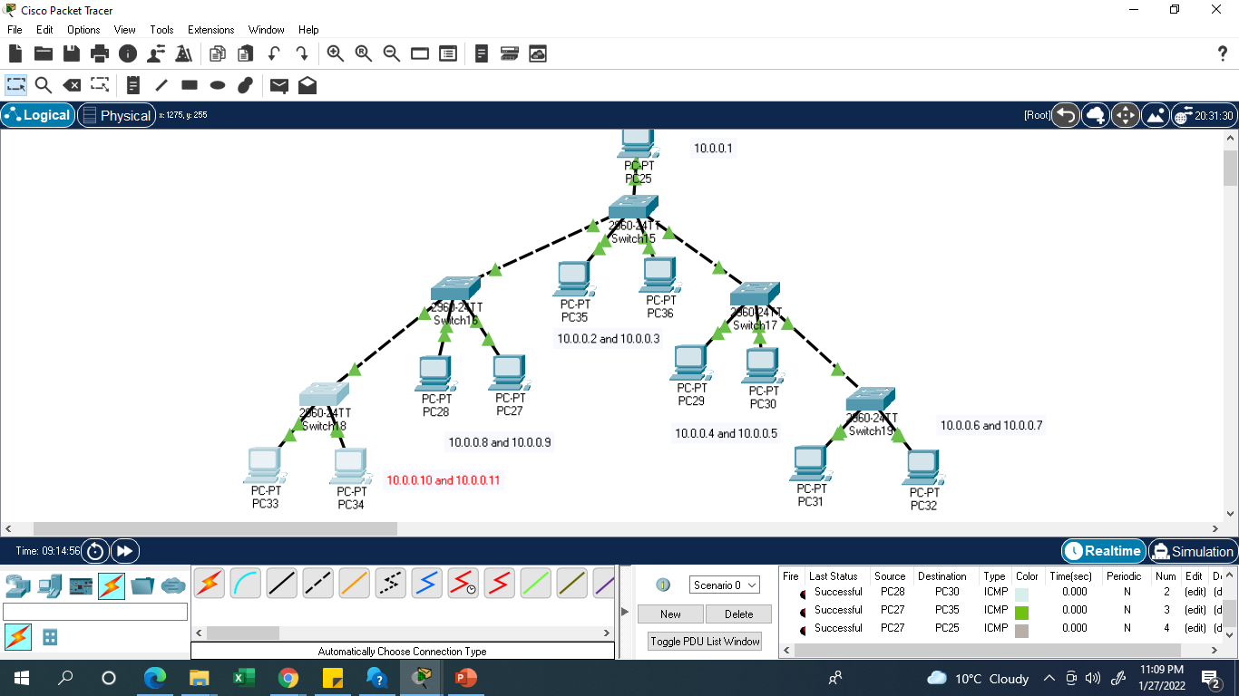

Slide 29
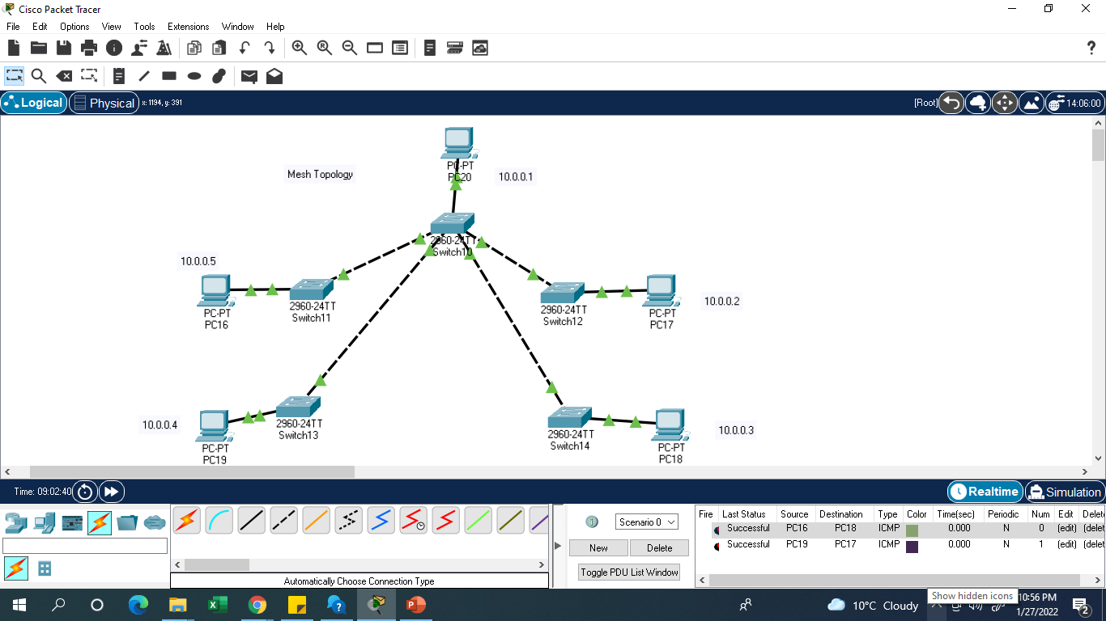

Slide 30
Hybrid Topology
A network which contain all type of physical structure and connected under a single backbone channel.

Slide 31
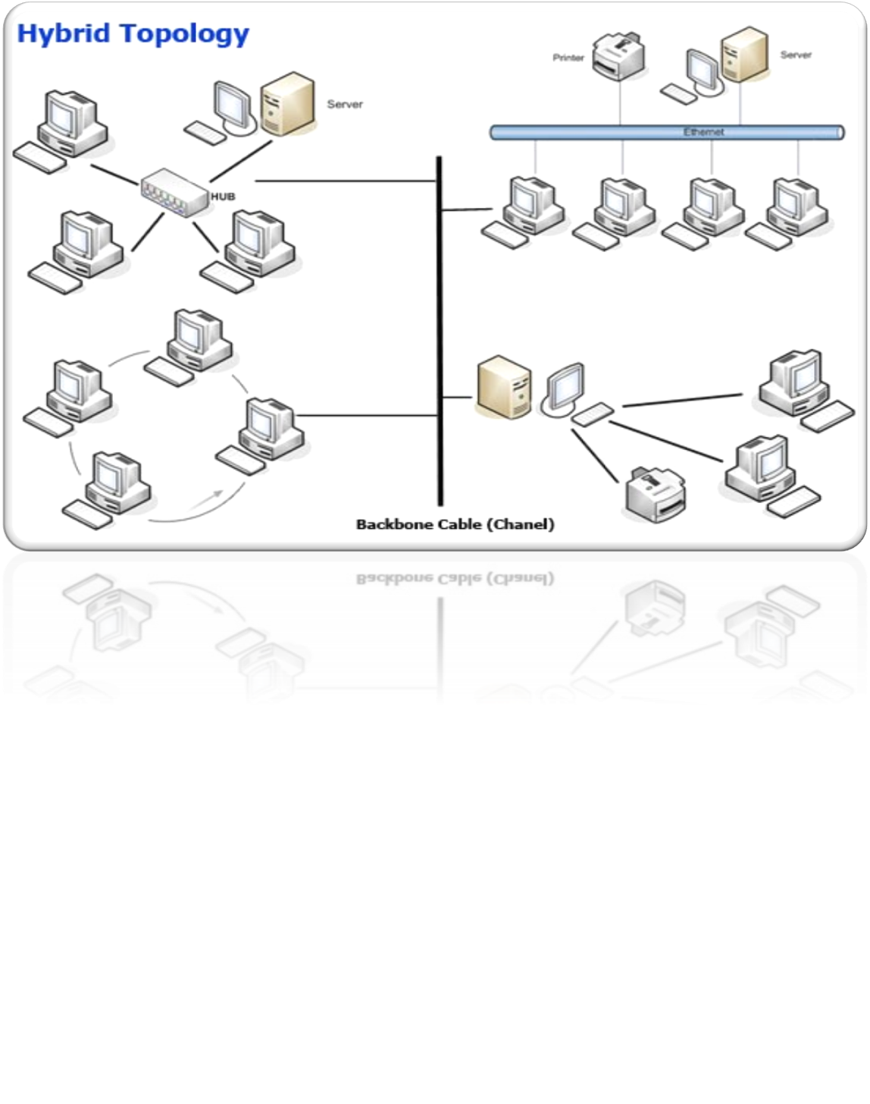

Slide 32

Hybrid Topology

Slide 33
